Slide 1
Bayes & Decision Tree Classifiers
Lecturer: Dr. Bo Yuan
E-mail: yuanb@sz.tsinghua.edu.cn

Slide 2
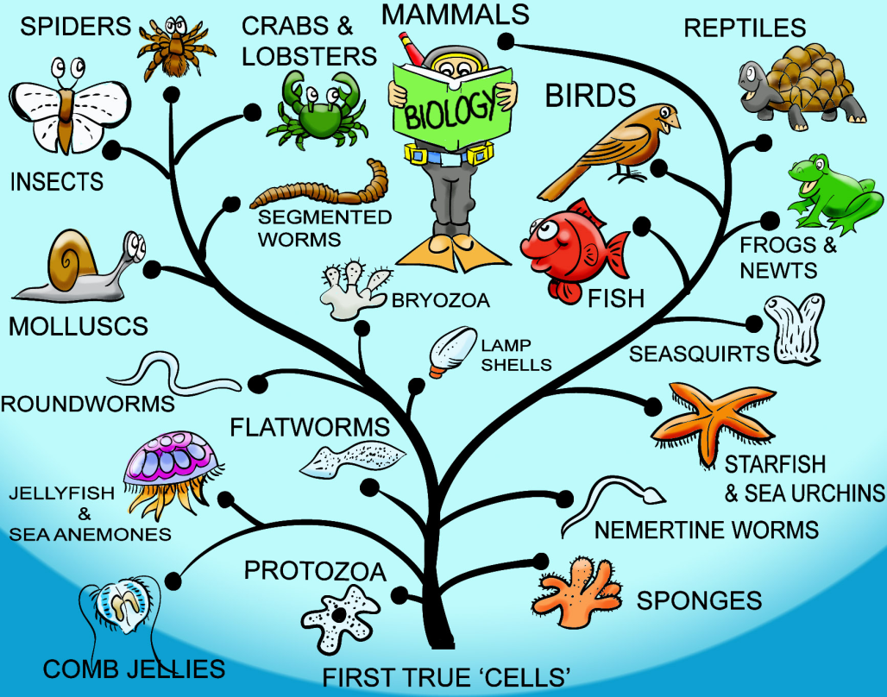

Overview
Naïve Bayes Classifier
Decision Tree Model
Thomas Bayes
Evolution Tree

Slide 3


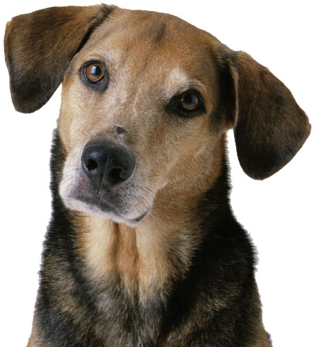

Classification

Slide 4
Definition
Classification is one of the fundamental skills for survival.
Food vs. Predator
A kind of supervised learning
Techniques for deducing a function from data
<Input, Output>
Input: a vector of features
Output: a Boolean value (binary classification) or integer (multiclass)
“Supervised” means:
A teacher or oracle is needed to label each data sample.
We will talk about unsupervised learning later.

Slide 5
Classifiers
{boy, girl}
Weight
Peter
Sam
Jack
Z=f(x,y)
Jane
Tom
Lisa
Helen
Mary
Height
Weight
Height

Slide 6

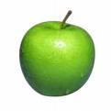
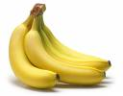
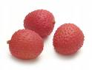
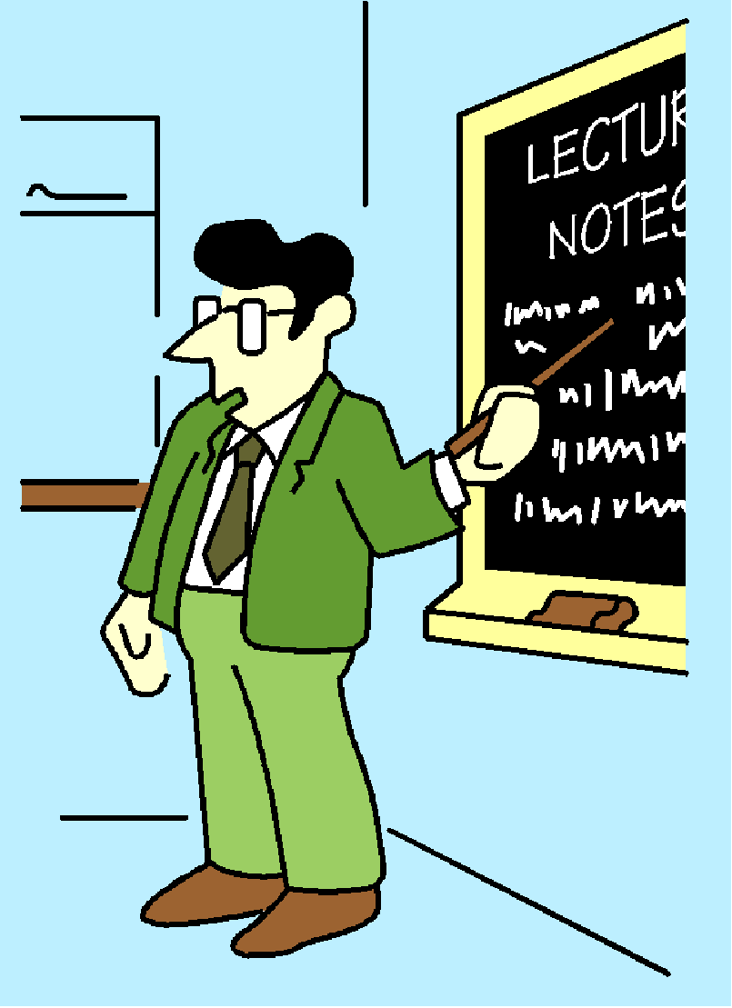
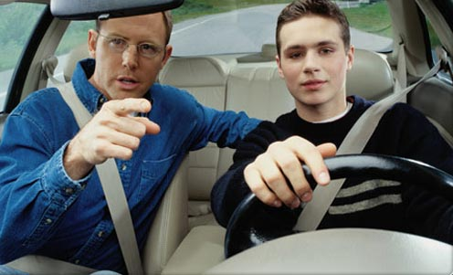
Training a Classifier
Learning

Slide 7
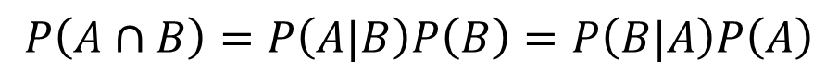
Bayes Theorem
A
B
$$P\left(A∪B\right)=P\left(A\right)+P\left(B\right)−P\left(A∩B\right)$$
$$P\left(A∩B\right)=P\left(A|B\right)P\left(B\right)=P\left(B|A\right)P\left(A\right)$$
Likelihood of evidence B if A is true
Prior probability
Posterior probability of A given the evidence B
Prior probability that evidence B is true

Slide 8
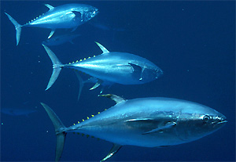
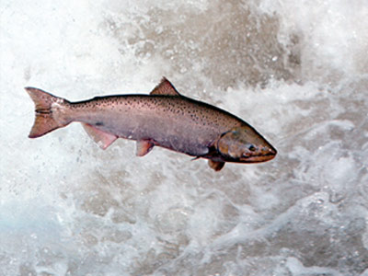
Fish Example
Salmon vs. Tuna
Grab a fish at random.
P(ω₁)=P(ω₂)
P(ω₁)>P(ω₂)
Additional information

Slide 9

Shooting Example
Probability of Kill
P(A): 0.6
P(B): 0.5
The target is killed with:
One shoot from A
One shoot from B
What is the probability that it is shot down by A?
C: The target is killed.
Notes:
因为A和B不互斥，所以P（B|C）不能简单的=1-3/4

Slide 10


Cancel Example
ω₁: Cancer; ω₂: Normal
P(ω₁)=0.008; P(ω₂)=0.992
Lab Test Outcomes: + vs. –
P(+|ω₁)=0.98; P(-|ω₁)=0.02
P(+|ω₂)=0.03; P(-|ω₂)=0.97
Now someone has a positive test result…
Is he/she doomed?

Slide 11

Cancel Example

Slide 12


Headache & Flu Example
H=“Having a headache”
F=“Coming down with flu”
P(H)=1/10; P(F)=1/40; P(H|F)=1/2
What does this mean?
One day you wake up with a headache …
Since 50% flu cases are associated with headaches …
I must have a 50-50 chance of coming down with flu!

Slide 13
Headache & Flu Example
The truth is …
Flu
Headache

Slide 14


Slide 15
Naïve Bayes Classifier
Conditionally Independent
MAP: Maximum A Posterior
Notes:
在实际中，P(a1,a2,……an|w)很难计算，特别是当属性个数很多的时候根本无法计算，
所以，增加了假设 ： 这些属性都条件独立
从而将公式简化为各个概率的乘积，即得到下面的公式。

Slide 16
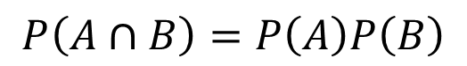
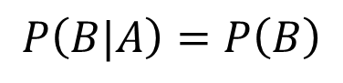
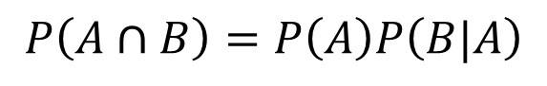
Independence
$$P\left(A∩B\right)=P\left(A\right)P\left(B|A\right)$$
$$P\left(B|A\right)=P\left(B\right)$$
$$P\left(A∩B\right)=P\left(A\right)P\left(B\right)$$
Conditionally Independent

Slide 17

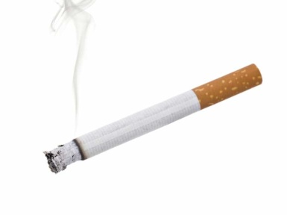
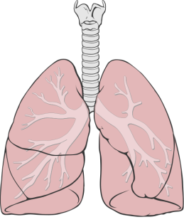
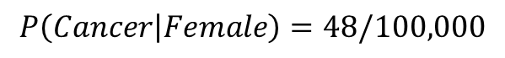
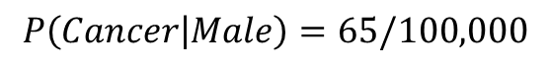
Conditional Independence
$$P\left(Cancer | Male\right)=65/100,000$$
$$P\left(Cancer | Female\right)=48/100,000$$
Are the two events Male/Female and Cancer independent?
Assume smoking is the sole contributing factor to cancer.
Conditionally Independent
$$P\left(Cancer | Male,Smoking\right)=P(Cancer|Smoking)$$
Notes:
实际上，是抽烟与肺癌有关系，而不是性别与肺癌有直接关系，

Slide 18
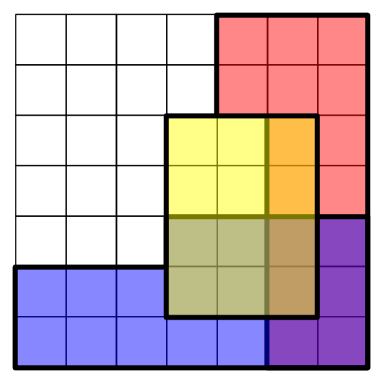
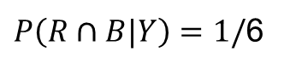
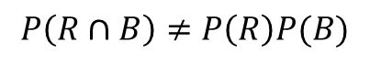
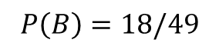
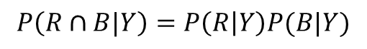
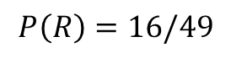
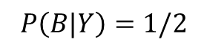
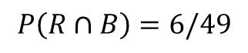
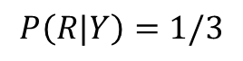
Conditional Independence
$$P\left(R∩B\right)=6/49$$
$$P\left(R\right)=16/49$$
$$P\left(B\right)=18/49$$
$$P\left(R∩B\right)≠P\left(R\right)P(B)$$
Not Independent
$P\left(R∩B|Y\right)=1/$6
$$P\left(R|Y\right)=1/3$$
$$P\left(B|Y\right)=1/2$$
$$P\left(R∩B|Y\right)=P\left(R | Y\right)P(B|Y)$$
Conditionally Independent
Notes:
条件独立和独立的区别：两个变量，可能原来不独立，加了条件后（相当于图中的Y），变独立了。

Slide 19
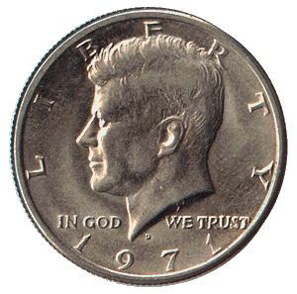


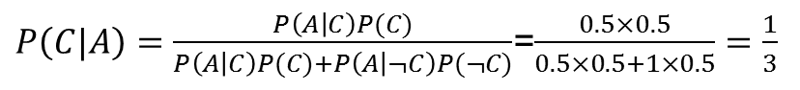
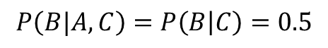
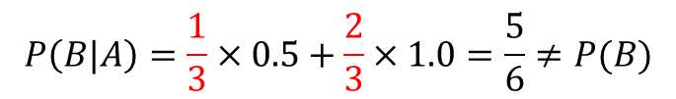
Conditional Independence
Two coins: fair vs. biased (two-headed)
Select one coin at random and toss twice.
A: First coin toss is head.
B: Second coin toss is head.
C: You selected the fair coin.
$$P\left(A\right)=P\left(B\right)=0.5×0.5+0.5×1.0=0.75$$
$P\left(C|A\right)=\frac{P\left(A | C\right)P(C)}{P\left(A | C\right)P(C)+P\left(A | ¬C\right)P(¬C)}$=$\frac{0.5×0.5}{0.5×0.5+1×0.5}=\frac{1}{3}$
$$P\left(B|A\right)=\frac{1}{3}×0.5+\frac{2}{3}×1.0=\frac{5}{6}≠P(B)$$
Not Independent
$$P\left(B|A,C\right)=P\left(B | C\right)=0.5$$
Conditionally Independent
Notes:
注意：随机选一个硬币，不换，抛两次 ，所以，两次之间不独立，但是硬币已订的前提下，两次独立
So，不是A影响了B，而是C影响了B
P(A)=P(A|C)P(C) + P(A|C补）P（C补）

Slide 20
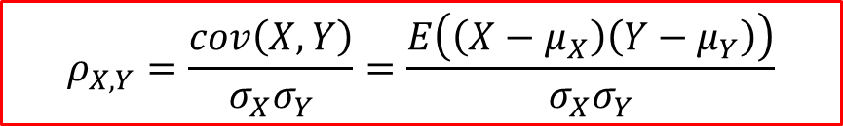
Independent ≠ Uncorrelated
$$ρ_{X,Y}=\frac{cov\left(X,Y\right)}{σ_{X}σ_{Y}}=\frac{E\left(\left(X−μ_{X}\right)\left(Y−μ_{Y}\right)\right)}{σ_{X}σ_{Y}}$$
Cov (X,Y)=0 → X and Y are uncorrelated.
However, Y is completely determined by X.
X | Y
1 | 1
0.5 | 0.25
0.2 | 0.04
0 | 0
-0.2 | 0.04
-0.5 | 0.25
-1 | 1

Slide 21
Estimating P(α_{j}|ω_{i})
α₁ | α₂ | α₃ | ω
 | + |  | ω₁
 |  |  | ω₂
 | - |  | ω₁
 | + |  | ω₁
 |  |  | ω₂
Laplace Smoothing
How about continuous variables?
Notes:
概率平滑：
1、分子+1是为了避免某类数据出现次数为0就认为概率为0（可能只是概率很小导致当前数据中没有出现），这样会导致概率乘积为0
2、分母+|aj|，即加上属性aj可能取值的数量，避免概率出现0的情况
对于连续变量，一般是用概率分布，如高斯分布等，然后按分布概率

Slide 22
Tennis Example

Slide 23
Tennis Example

Slide 24
Text Classification Example
Interesting? Boring?
Politics? Entertainment? Sports?

Slide 25
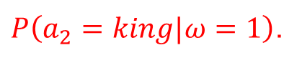
Text Representation
α₁ | α₂ | α₃ | α₄ | … | α_{n} | ω
Long | long | ago | there | … | king | 1
New | sanctions | will | be | … | Iran | 0
Hidden | Markov | models | are | … | method | 0
The | Federal | Court | today | … | investigate | 0
We need to estimate probabilities such as
$P\left(a_{2}=king|ω=1\right)$.
However, there are 2×n×|Vocabulary| terms in total. For n=100 and a
vocabulary of 50,000 distinct words, it adds up to 10 million terms!

Slide 26

Text Representation
By only considering the probability of encountering a specific word instead of the specific word position, we can reduce the number of probabilities to be estimated.
We only count the frequency of each word.
Now, 2×50,000=100,000 terms need to be estimated.
n: the total number of word positions in all training samples whose target value is ω_{i}.
n_{k}: the number of times word V_{k} is found among these n positions.

Slide 27
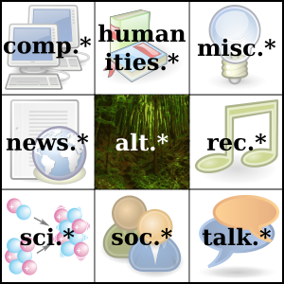
Case Study: Newsgroups
Classification
Joachims, 1996
20 newsgroups
20,000 documents
Random Guess: 5%
NB: 89%
Recommendation
Lang, 1995
NewsWeeder
User rated articles
Interesting vs. Uninteresting
Top 10% selected articles
16% vs. 59%

Slide 29

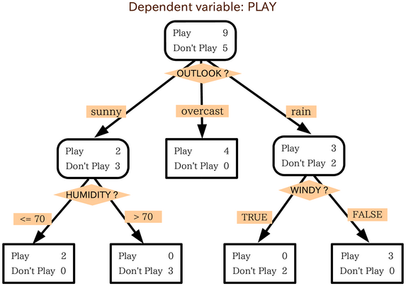


Decision Making

Slide 30
A Survey Dataset
Given the data collected from a promotion activity.
Could be tens of thousands of such records.
Can we find any interesting patterns?
All rural households responded …
To find out which factors most strongly affect a household’s response to a promotion.
Better understanding of potential customers
Need a classifier to examine the underlying relationships and make future predictions.
Send promotion brochures to selected households next time.
Targeted Marketing

Slide 31
A Survey Dataset
District | House Type | Income | Previous Customer | Outcome
Suburban | Detached | High | No | Nothing
Suburban | Detached | High | Yes | Nothing
Rural | Detached | High | No | Responded
Urban | Semi-detached | High | No | Responded
Urban | Semi-detached | Low | No | Responded
Urban | Semi-detached | Low | Yes | Nothing
Rural | Semi-detached | Low | Yes | Responded
Suburban | Terrace | High | No | Nothing
Suburban | Semi-detached | Low | No | Responded
Urban | Terrace | Low | No | Responded
Suburban | Terrace | Low | Yes | Responded
Rural | Terrace | High | Yes | Responded
Rural | Detached | Low | No | Responded
Urban | Terrace | High | Yes | Nothing

Slide 32
A Tree Model
District
Suburban
2 : 3
Rural
4 : 0
Urban
3 : 2
House Type
Previous Customer
Detached
0 : 2
Terrace
1 : 1
Semi-detached
1 : 0
Yes
0 : 2
No
3 : 0
Income
Red: Responded
Purple: Nothing
High
0 : 1
Low
1 : 0

Slide 33
Another Tree Model
District
Suburban
2 : 3
Rural
4 : 0
Urban
3 : 2
Income
Previous Customer
High
0 : 3
Low
2 : 0
Yes
0 : 2
No
3 : 0
Red: Responded
Purple: Nothing

Slide 34
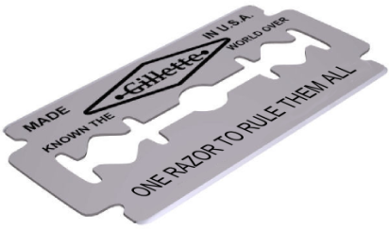
Some Notes …
Rules can be easily extracted from the built tree.
(District = Rural) → (Outcome = Responded)
(District = Urban) AND (Previous Customer = Yes) → (Outcome = Nothing)
One dataset, many possible trees
Occam‘s Razor --- 效果相同时，选简单的
The term razor refers to the act of shaving away unnecessary assumptions to get to the simplest explanation.
“When you have two competing theories that make exactly the same predictions, the simpler one is the better.”
“The explanation of any phenomenon should make as few assumptions as possible, eliminating those making no difference in the observable predictions of the explanatory hypothesis or theory.”
Simpler trees are generally preferred.

Slide 36
ID3
How to build a shortest tree from a dataset?
Iterative Dichotomizer 3
Ross Quinlan: http://www.rulequest.com/
One of the most influential Decision Trees models
Top-down, greedy search through the space of possible decision trees
Since we want to construct short trees …
It is better to put certain attributes higher up the tree.
Some attributes split the data more purely than others.
Their values correspond more consistently with the class labels.
Need to have some sort of measure to compare candidate attributes.

Slide 37
Entropy
p_{i}: the proportion of instances in the dataset that take the i ^{th} target value
S_{v}: the subset of S where attribute A takes the value v.

Slide 38
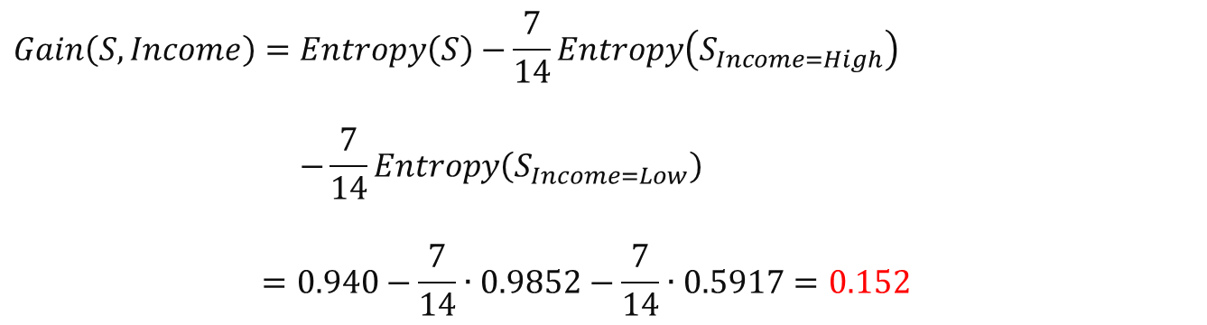
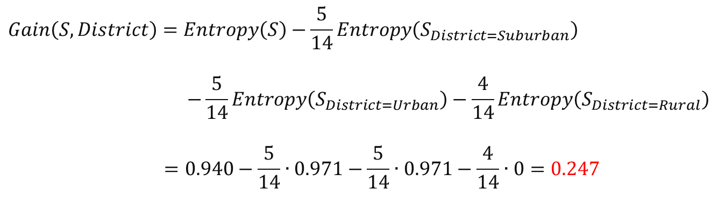
Attribute Selection
$$Gain\left(S, District\right)=Entropy\left(S\right)−\frac{5}{14}Entropy\left(S_{District=Suburban}\right)$$
$$−\frac{5}{14}Entropy\left(S_{District=Urban}\right)−\frac{4}{14}Entropy\left(S_{District=Rural}\right)$$
$$=0.940−\frac{5}{14}∙0.971−\frac{5}{14}∙0.971−\frac{4}{14}∙0=0.247$$
$$Gain\left(S, Income\right)=Entropy\left(S\right)−\frac{7}{14}Entropy\left(S_{Income=High}\right)$$
$$−\frac{7}{14}Entropy\left(S_{Income=Low}\right)$$
$$=0.940−\frac{7}{14}∙0.9852−\frac{7}{14}∙0.5917=0.152$$

Slide 39
ID3 Framework
ID3(Examples, Target_attribute, Attributes)
Create a Root node for the tree.
If Examples have the same target attribute T, return Root with label=T.
If Attributes is empty, return Root with label=the most common value of Target_attribute in Examples.
A ← the attribute from Attributes that best classifies Examples.
The decision attribute for Root ← A.
For each possible value v_{i} of A
Add a new tree branch below Root, corresponding to A= v_{i}.
Let Examples (v_{i}) be the subset of Examples that have value v_{i} for A.
If Examples (v_{i}) is empty
Below this new branch add a leaf node with label=the most common value of Target_attribute in Examples.
Else below this new branch add the subtree
ID3(Examples(v_{i}), Target_attribute, Attributes-{A})
Return Root
Notes:
1、一个属性只能用一次
2、某个节点label是一样的，停止
3、属性用完了，还是不纯，就少数服从多数

Slide 40
ID3 Framework
{♠♠♠♠♠♠♠♠♠♣♣♣♣}
A₁
{♠♠♠}
{♠♠♠♠♠♠♣♣♣♣}
A₂
3 : 0
Pure node, stop!
Empty node, stop!
1 : 3
5 : 1
0 : 0
No more attributes, stop!
Decision Nodes
Leaf Nodes

Slide 41
Overfitting
It is possible to create a separate rule for each training sample.
Perfect Training Accuracy vs. Overfitting
Random Noise, Insufficient Samples
We want to capture the general underlying functions or trends.
Definition
Given a hypothesis space H, a hypothesis h ∈ H is said to overfit the training data if there exists some alternative hypothesis h' ∈ H, such as h has smaller error than h' over the training samples, but h' has a smaller error than h over the entire distribution of instances.
Solutions
Stop growing the tree earlier.
Allow the tree to overfit the data and then post-prune the tree.

Slide 42
Pruning
Training Set
Validation Set
Test Set
9 : 5
1 : 3
8 : 2
Decision Nodes
Leaf Nodes
Notes:
在training Set上训练树
在validation Set上，一边剪枝，一边观察validation上的误差率，出现拐点的地方，就停下来。

Slide 43
Entropy Bias
The entropy measure guides the entire tree building process.
There is a natural bias that favours attributes with many values.
Consider the attribute “Birth Date”
Separate the training data into very small subsets.
Very high information gain
A very poor predicator of the target function over unseen instances.
Such attributes need to be penalized!
Notes:
某些属性，对算法来说区分度很好，但是容易把数据集划分的很细，这种属性不好。
属性把记录切分的越琐碎，splitInformation值越大。

Slide 44
Continuous Attributes
Samples are sorted based on Temperature.
Temperature | 40 | 48 | 60 | 72 | 80 | 90
Play Tennis | No | No | Yes | Yes | Yes | No
Threshold A
Threshold B
Notes:
连续型属性：把它离散化
好的Threshold，一定出现在输出结果变化的地方

Slide 45
Reading Materials
Online Tutorial
http://www.decisiontrees.net/node/21 (with interactive demos)
http://www.autonlab.org/tutorials/dtree18.pdf
http://people.revoledu.com/kardi/tutorial/DecisionTree/index.html
http://www.public.asu.edu/~kirkwood/DAStuff/decisiontrees/index.html
Tom Mitchell, Machine Learning, Chapters 3&6, McGraw-Hill.
Additional reading about Naïve Bayes Classifier
http://www-2.cs.cmu.edu/~tom/NewChapters.html
Software for text classification using Naïve Bayes Classifier
http://www-2.cs.cmu.edu/afs/cs/project/theo-11/www/naive-bayes.html

